Slide 1
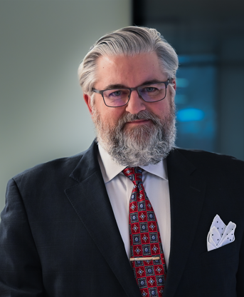
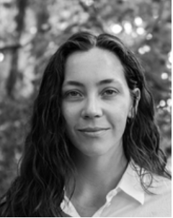
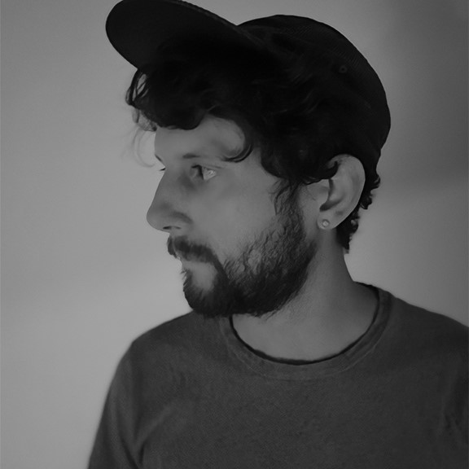
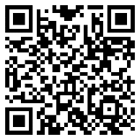
School of Art Visiting Artist & Scholars Lecture Series and Dr. Flavia Bastos presents:
Is AI Art really Art? Exploring Creativity and Authenticity
Tim Armstrong interrogates the relationship between AI and copyright law, focusing on the questions that have challenged the courts, namely: (1) Does the act of “training” an AI algorithm infringe copyrights in the works that were used to train the system? (2) Does the act of generating a new work using an AI system infringe copyrights in any of the training works? And (3) May a work generated by an AI system receive protection under copyright law against being copied by others?
Artists are increasingly collaborating with AI algorithms to push the boundaries of art and using technology as a tool to amplify their creative vision. At the heart of the AI and art debate lies the concept of creativity. Traditionally, creativity has been associated with human ingenuity, the ability to connect disparate ideas, and the expression of unique perspectives. But can machines, driven by algorithms and data, truly be creative? This panel discussion examines the possibilities, limitations, and liabilities of leveraging artificial intelligence to create art. Three panelists will reflect upon the entanglements AI promotes between technology and human emotion, and its effects in reshaping the landscape of artistic expression, and challenging established social practices and assumptions.
Caroline Turner is an artist who has incorporated AI as a sophisticated ideation tool. Collaborating with ChatGPT in myriad ways to produce speculative fictional texts, she has used various text-to-image models to develop a bespoke workflow using 3D modeling software. Her recent work is 3D-animated video, RETROCAUSAL, prompted AI to imagine nonlinear hybridized architectural archways that represent both the past and future simultaneously.
Tim Armstrong interrogates the relationship between AI and copyright law, focusing on the questions that have challenged the courts, namely: (1) Does the act of “training” an AI algorithm infringe copyrights in the works that were used to train the system? (2) Does the act of generating a new work using an AI system infringe copyrights in any of the training works? And (3) May a work generated by an AI system receive protection under copyright law against being copied by others?
RSVP
February 19, 2024
5 pm
Zoom

